Slide 1
Team4 Edupy Final Presentation : Web Service Program for Chat-bot Education in Python
Team4 2016312117 양이삭
Team4 2015313456 김창헌
Team4 2017314786 정동진
Team4 2019310847 송예진
Team4 2019315437 최가은
Team4 2020311323 손영훈

Slide 2
CONTENTS
1. OVERVIEW
Service Outline
2. GOAL & METHOD
Our Goal
Development Tools
Team Formation
3. REQUIREMENT
Functional Requirement
Non-functional Requirement
4. IMPLEMENTATION
Sub-system Implementation
5. COMPLEMENTRY
Problems in System
1. OVERVIEW
...... slide 3
2. GOAL & METHOD
...... slide 4
...... slide 5
...... slide 6
3. REQUIREMENT
...... slide 7
...... slide 8
4. IMPLEMENTATION
...... slide 9
5. COMPLEMENTRY
...... slide 13

Slide 3




OVERVIEW
Service Outline

Slide 4





GOAL & METHOD
Our Goal
User Management
Managing user account using DB for checking curriculum
Curriculum
Service curriculum contents and tests
Python & Web Editor
Provide Python & Web editing service for code practice
Board
Provide web board for communication for users and admin

Slide 5




GOAL & METHOD
Development Tools
JavaScript
Front-end development tool
HTML
Front-end development tool
CSS
Front-end development tool
MariaDB
Back-end development tool

Slide 6
GOAL & METHOD
Team Formation
Requirement
Specification
양이삭 김창헌 정동진 송예진 최가은 손영훈
Design
Specification
양이삭 김창헌 정동진 송예진 최가은 손영훈
Front-end
김창헌 정동진 손영훈 양이삭
Back-end
송예진 최가은
Documentation
양이삭 김창헌 정동진 송예진 최가은 손영훈

Slide 7
REQUIREMENT
Functional Requirement
Plan in <Requirement Specification>
Req.1
Sign In
Req.2
Log In
Req.3
Studying Curriculum
Req.4
Exercise Problems
Req.5
Checking Scoring Result of Problems

Slide 8
REQUIREMENT
Non-functional Requirement
Plan in <Requirement Specification>
Product Requirement
Usability req. (UI)
Efficiency req.
Dependability req.
Security req.
Organization Requirement
Environmental req.
Operational req.
Development req.
External Requirement
Regulatory req. / Legislative req.
Ethical req.
Safety req. / Security req.

Slide 9
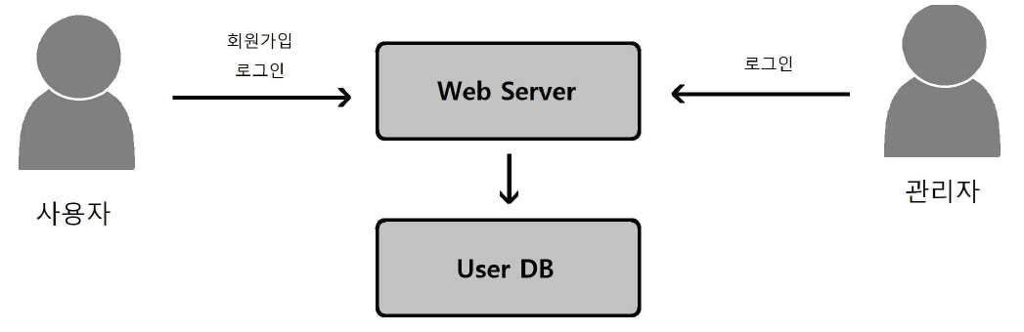
IMPLEMENTATION
Sub-systems Implementation
User Management System
Diagram in <Design Specification>

Slide 10
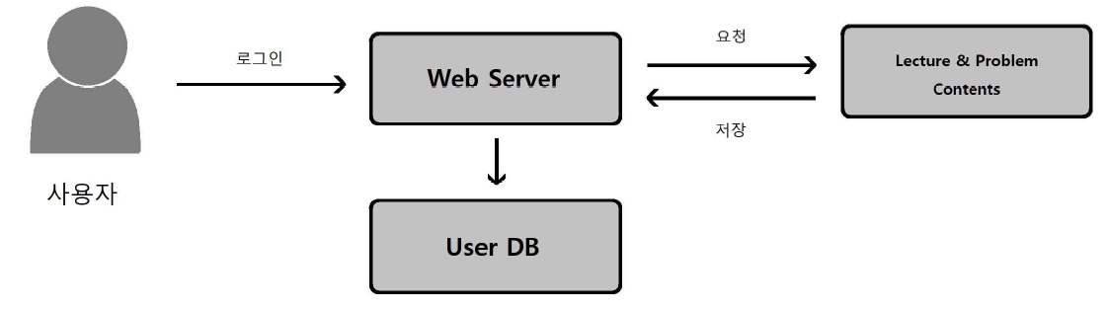
IMPLEMENTATION
Sub-systems Implementation
Curriculum System
Diagram in <Design Specification>

Slide 11
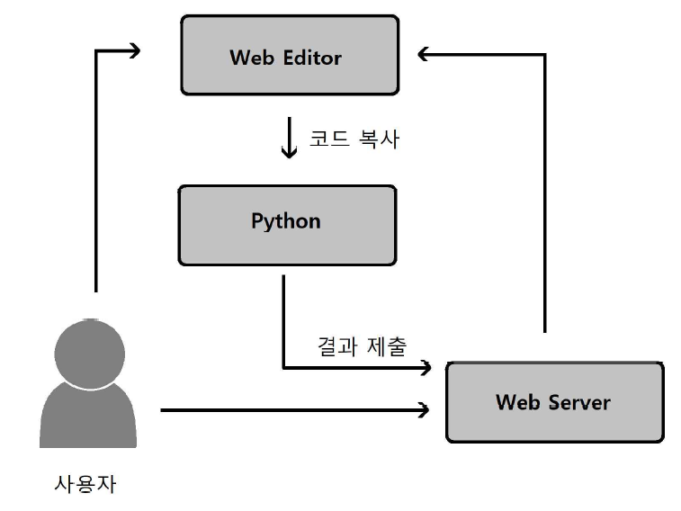
IMPLEMENTATION
Sub-systems Implementation
Python & Web Editor System
Diagram in <Design Specification>

Slide 12
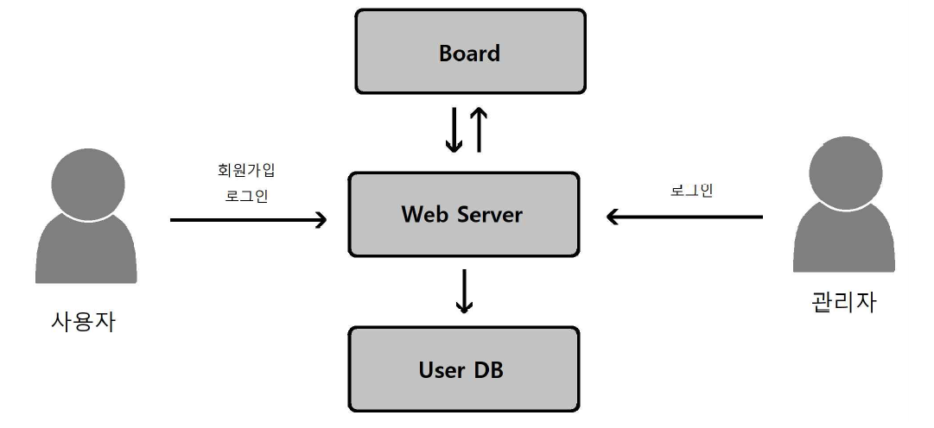
IMPLEMENTATION
Sub-systems Implementation
Board System
Diagram in <Design Specification>

Slide 13


COMPLEMENTARY
Problems in System
Deployment
This project could not be deployed through the domain because it would incur the cost of purchasing the domain if we try to use the domain for Edupy's deployment.
Therefore this demonstration will be conducted on the team member's computer with the database.

Slide 14


COMPLEMENTARY
Problems in System
Lack of curriculum and content
Edupy was developed with the goal of a web service system for real-time chat implementation on Python but can then add curriculum or educational content.
However, it currently has only one curriculum, which can lead to a lack of user interest and a lack of use cases.

Slide 15
Demonstration
Team4 2016312117 양이삭
Team4 2015313456 김창헌
Team4 2017314786 정동진
Team4 2019310847 송예진
Team4 2019315437 최가은
Team4 2020311323 손영훈

